Slide 1
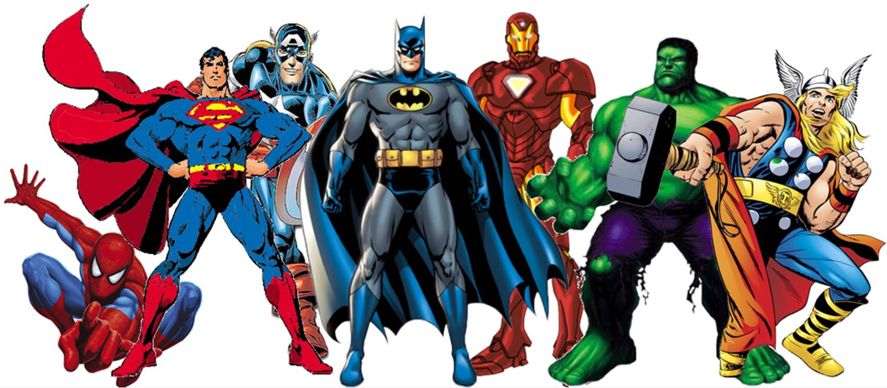
Rating Superheroes using Collaborative Filtering

Slide 2
 | Sagar | Harshit | Jagan | Saivalini | Jayant | Mean
Captain America | 9 | 7 | NA | 7 | NA | 7.7
Thor | 9 | 10 | NA | 9 | NA | 9.3
Ironman | 9 | 6 | NA | 8 | 6 | 7.3
Black Widow | 10 | 7 | NA | NA | NA | 8.5
Hulk | 4 | 10 | NA | 4 | 5 | 5.8
Spiderman | 7 | 5 | NA | 8 | 8 | 7
Batman | 6 | 5 | 5 | 5 | 6 | 5.4
Superman | 7 | 5 | NA | 8 | 7 | 6.8
Wonder Woman | 10 | 8 | NA | 9 | 5 | 8
Hanuman | 7 | 4 | 8 | 7 | 9 | 7
Bahubali | NA | 4 | 10 | 9 | 10 | 8.3
Mean | 7.8 | 6.5 | 7.5 | 7.4 | 7 | 7.2
Collaborative filtering is seen as a system that recommends items based on user or item similarity.
But at the core the task can be broken down into “filling NAs”
i.e. You basically find the likely rating a user may give to a product. If the rating is high enough, you recommend the product.

Slide 3
 | Sagar | Harshit | Jagan | Saivalini | Jayant | Mean
Captain America | 9 | 7 | NA | 7 | NA | 7.7
Thor | 9 | 10 | NA | 9 | NA | 9.3
Ironman | 9 | 6 | NA | 8 | 6 | 7.3
Black Widow | 10 | 7 | NA | NA | NA | 8.5
Hulk | 4 | 10 | NA | 4 | 5 | 5.8
Spiderman | 7 | 5 | NA | 8 | 8 | 7
Batman | 6 | 5 | 5 | 5 | 6 | 5.4
Superman | 7 | 5 | NA | 8 | 7 | 6.8
Wonder Woman | 10 | 8 | NA | 9 | 5 | 8
Hanuman | 7 | 4 | 8 | 7 | 9 | 7
Bahubali | NA | 4 | 10 | 9 | 10 | 8.3
Mean | 7.8 | 6.5 | 7.5 | 7.4 | 7 | 7.2
Task - predict R(Sagar, Bahubali)
Approach 1 - Predict average rating that Sagar gives (7.8)
Challenge – Ignores the variance in Sagar’s rating
Sagar may like some movies and may not like some movies.
Basically there is some variance in the rating given by Sagar.
Approximating by mean value neglects that variance.

Slide 4
 | Sagar | Harshit | Jagan | Saivalini | Jayant | Mean
Captain America | 9 | 7 | NA | 7 | NA | 7.7
Thor | 9 | 10 | NA | 9 | NA | 9.3
Ironman | 9 | 6 | NA | 8 | 6 | 7.3
Black Widow | 10 | 7 | NA | NA | NA | 8.5
Hulk | 4 | 10 | NA | 4 | 5 | 5.8
Spiderman | 7 | 5 | NA | 8 | 8 | 7
Batman | 6 | 5 | 5 | 5 | 6 | 5.4
Superman | 7 | 5 | NA | 8 | 7 | 6.8
Wonder Woman | 10 | 8 | NA | 9 | 5 | 8
Hanuman | 7 | 4 | 8 | 7 | 9 | 7
Bahubali | NA | 4 | 10 | 9 | 10 | 8.3
Mean | 7.8 | 6.5 | 7.5 | 7.4 | 7 | 7.2
Task - predict R(Sagar, Bahubali)
Approach 2 - Predict average rating of Bahubali (8.3)
Challenge – Ignores the variance across the users
Some users may like the movie and some may not.
Approximating by mean value neglects the difference of opinions across the users.

Slide 5
 | Sagar | Harshit | Jagan | Saivalini | Jayant | Mean
Captain America | 9 | 7 | NA | 7 | NA | 7.7
Thor | 9 | 10 | NA | 9 | NA | 9.3
Ironman | 9 | 6 | NA | 8 | 6 | 7.3
Black Widow | 10 | 7 | NA | NA | NA | 8.5
Hulk | 4 | 10 | NA | 4 | 5 | 5.8
Spiderman | 7 | 5 | NA | 8 | 8 | 7
Batman | 6 | 5 | 5 | 5 | 6 | 5.4
Superman | 7 | 5 | NA | 8 | 7 | 6.8
Wonder Woman | 10 | 8 | NA | 9 | 5 | 8
Hanuman | 7 | 4 | 8 | 7 | 9 | 7
Bahubali | NA | 4 | 10 | 9 | 10 | 8.3
Mean | 7.8 | 6.5 | 7.5 | 7.4 | 7 | 7.2
Global mean rating = 7.2
Bahubali’s mean rating = 8.3
Bahubali is rated 1.1 units higher than average
Bias of +1.1
Global mean rating = 7.2
Sagar’s mean rating = 7.8
Sagar rates movies 0.6 higher than average
Bias of 0.6
* Note that bias can be negative also. E.g.. Harshit has a bias of -0.7

Slide 6
 | Sagar | Harshit | Jagan | Saivalini | Jayant | Mean
Captain America | 9 | 7 | NA | 7 | NA | 7.7
Thor | 9 | 10 | NA | 9 | NA | 9.3
Ironman | 9 | 6 | NA | 8 | 6 | 7.3
Black Widow | 10 | 7 | NA | NA | NA | 8.5
Hulk | 4 | 10 | NA | 4 | 5 | 5.8
Spiderman | 7 | 5 | NA | 8 | 8 | 7
Batman | 6 | 5 | 5 | 5 | 6 | 5.4
Superman | 7 | 5 | NA | 8 | 7 | 6.8
Wonder Woman | 10 | 8 | NA | 9 | 5 | 8
Hanuman | 7 | 4 | 8 | 7 | 9 | 7
Bahubali | NA | 4 | 10 | 9 | 10 | 8.3
Mean | 7.8 | 6.5 | 7.5 | 7.4 | 7 | 7.2
Task - predict R(Sagar, Bahubali)
Approach 3 – Rating = Global average + Item bias + User bias
R(Sagar, Bahubali) = 7.2 + 1.1 + 0.6 = 8.9
*Note – Bias can be statistically significant only when you have sufficient data. E.g. Jagan has rated only 4 movies, so its not sensible to estimate Jagan’s bias. We consider bias to be 0 in such cases.

Slide 7
 | Sagar | Harshit | Jagan | Saivalini | Jayant | Mean
Captain America | 9 | 7 | NA | 7 | NA | 7.7
Thor | 9 | 10 | NA | 9 | NA | 9.3
Ironman | 9 | 6 | NA | 8 | 6 | 7.3
Black Widow | 10 | 7 | NA | NA | NA | 8.5
Hulk | 4 | 10 | NA | 4 | 5 | 5.8
Spiderman | 7 | 5 | NA | 8 | 8 | 7
Batman | 6 | 5 | 5 | 5 | 6 | 5.4
Superman | 7 | 5 | NA | 8 | 7 | 6.8
Wonder Woman | 10 | 8 | NA | 9 | 5 | 8
Hanuman | 7 | 4 | 8 | 7 | 9 | 7
Bahubali | NA | 4 | 10 | 9 | 10 | 8.3
Mean | 7.8 | 6.5 | 7.5 | 7.4 | 7 | 7.2
Can we do better??
We are considering all users to estimate the rating. However in reality not all users are same, neither are all movies.
So ideally we should be using similar users or movies for better approximation.

Slide 8
 | Sagar | Harshit | Jagan | Saivalini | Jayant | Mean
Captain America | 9 | 7 | NA | 7 | NA | 7.7
Thor | 9 | 10 | NA | 9 | NA | 9.3
Ironman | 9 | 6 | NA | 8 | 6 | 7.3
Black Widow | 10 | 7 | NA | NA | NA | 8.5
Hulk | 4 | 10 | NA | 4 | 5 | 5.8
Spiderman | 7 | 5 | NA | 8 | 8 | 7
Batman | 6 | 5 | 5 | 5 | 6 | 5.4
Superman | 7 | 5 | NA | 8 | 7 | 6.8
Wonder Woman | 10 | 8 | NA | 9 | 5 | 8
Hanuman | 7 | 4 | 8 | 7 | 9 | 7
Bahubali | NA | 4 | 10 | 9 | 10 | 8.3
Mean | 7.8 | 6.5 | 7.5 | 7.4 | 7 | 7.2
Task - predict R(Sagar, Bahubali)
Approach 4 – User the ratings of users similar to Sagar
Sagar – Harshit => 0.94
Sagar – Jagan => 0.99
Sagar – Saivalini => 0.99
Sagar – Jayant => 0.95
Considering 2 nearest neighbours (K=2)
Rating(Sagar) = mean(Saivalini, Jayant)
= mean(9,10)
= 9.5
Note – Jagan isn’t considered because he hasn’t seen enough movies to demonstrate any reliable pattern

Slide 9
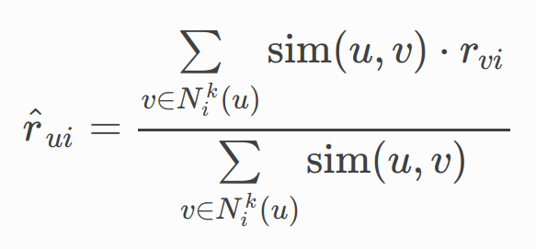
 | Sagar | Harshit | Jagan | Saivalini | Jayant | Mean
Captain America | 9 | 7 | NA | 7 | NA | 7.7
Thor | 9 | 10 | NA | 9 | NA | 9.3
Ironman | 9 | 6 | NA | 8 | 6 | 7.3
Black Widow | 10 | 7 | NA | NA | NA | 8.5
Hulk | 4 | 10 | NA | 4 | 5 | 5.8
Spiderman | 7 | 5 | NA | 8 | 8 | 7
Batman | 6 | 5 | 5 | 5 | 6 | 5.4
Superman | 7 | 5 | NA | 8 | 7 | 6.8
Wonder Woman | 10 | 8 | NA | 9 | 5 | 8
Hanuman | 7 | 4 | 8 | 7 | 9 | 7
Bahubali | NA | 4 | 10 | 9 | 10 | 8.3
Mean | 7.8 | 6.5 | 7.5 | 7.4 | 7 | 7.2
Rating(Sagar) = mean(Saivalini, Jayant)
Sagar – Saivalini => 0.99
Sagar – Jayant => 0.95
Saivalini is more closer to Sagar. So ideally her rating should be given higher weightage.
Rating = 0.99(Saivalini) + 0.95(Jayant) (0.99 + 0.95)

